Slide 1


deepwalk: online learning of social representations
Junhee Cho
Network Science Lab
The Catholic University of Korea
E-mail : junhe0733@gmail.com

Slide 2
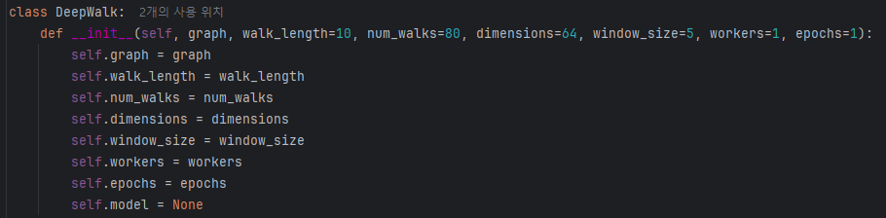
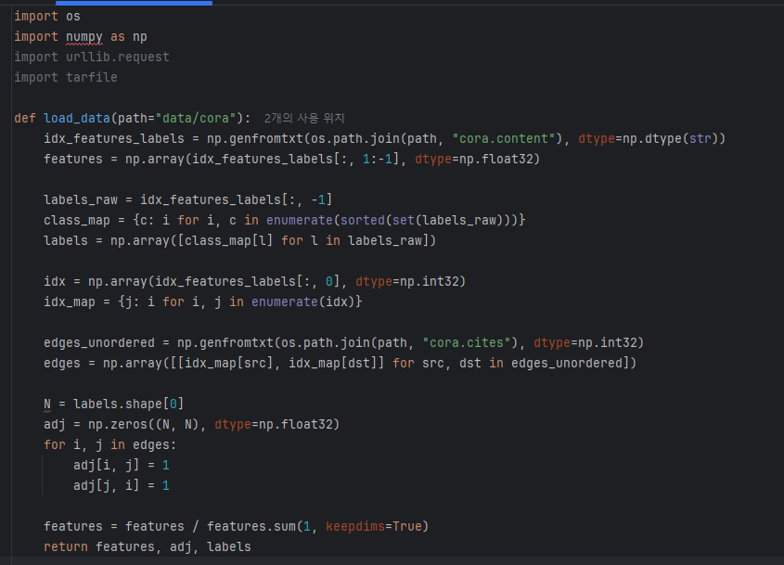

Code
Initialization

Slide 3
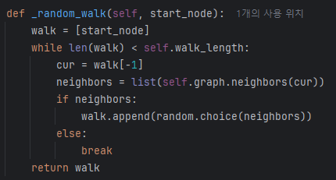
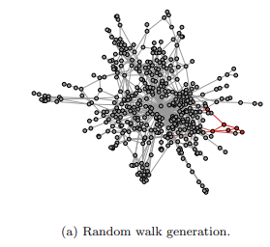
Code
generate a single random walk

Slide 4
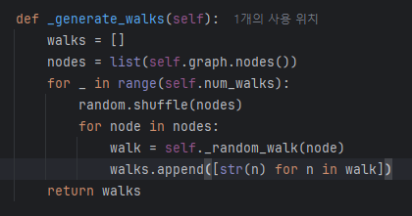
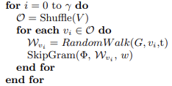
Code
Generate multiple random walks

Slide 5
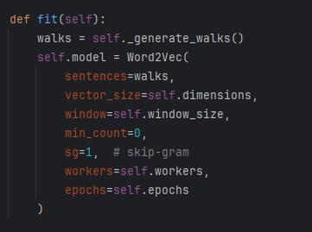
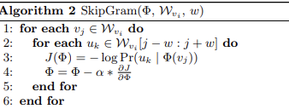
output
train Word2Vec model

Slide 6
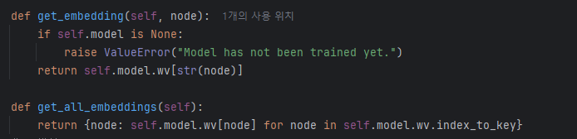
output
Embedding

Slide 7
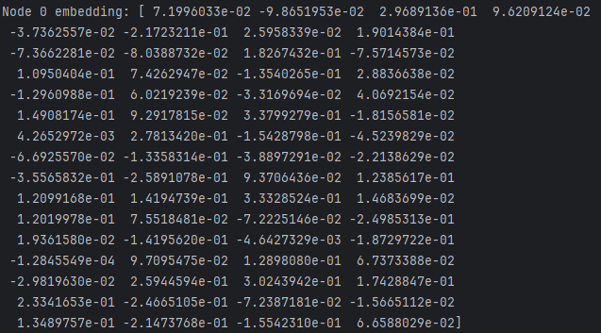
output
Embedding result

Slide 8
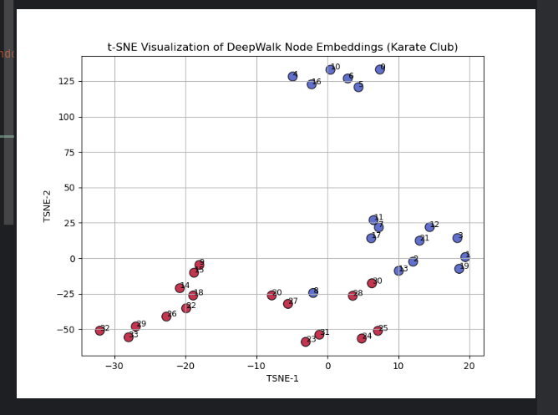
output
Visualization

